Slide 1





2019 Pollinator Garden Project
At the Ewing Senior and Community Center

Slide 2
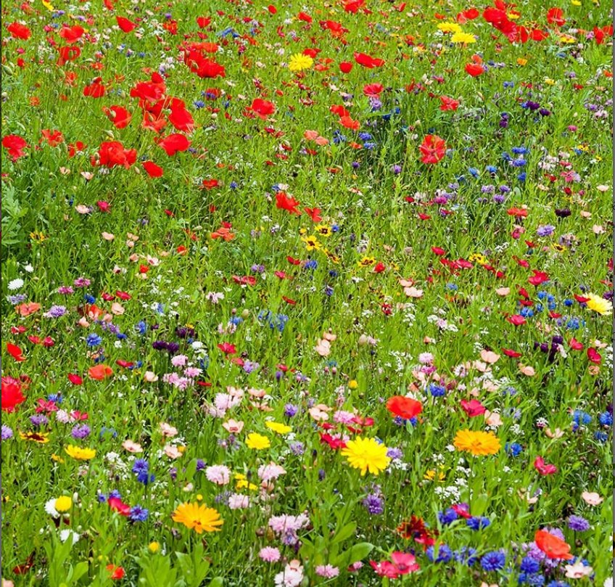
About This Project
Funding
  Funded by a grant from ANJEC
  $1500
  1st Phase - this fall –
  Final phase in the spring
Plant Choices
  Wildlife value following…

Slide 3

Why bother?
Extinction Crisis – the Sixth Extinction
for plants and animals alike
Accelerating
Causes:
  Invasive species
  Loss of habitat due to overdevelopment and farming
  Pollution and use of chemicals in the landscape – herbicides, pesticides…
  Changes due to global warming
  Overexploitation of resources

Slide 4
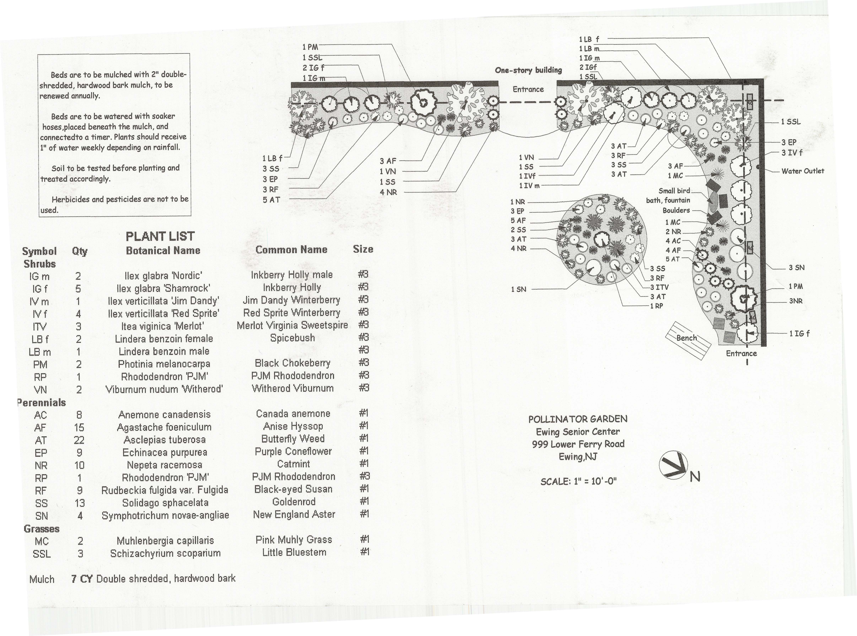

Slide 5
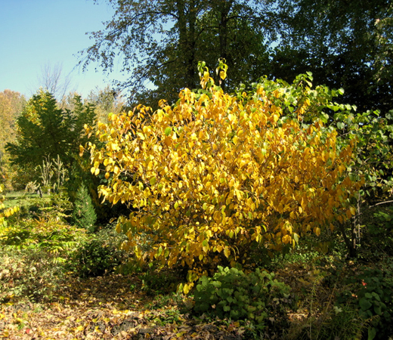
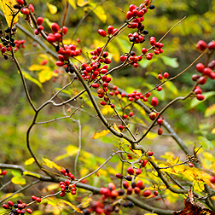
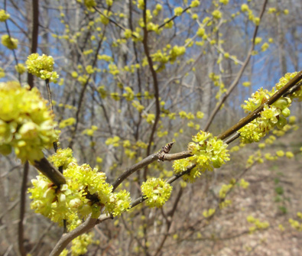
Lindera Benzoin - Spicebush
Great plant for birds and butterflies
Host plant for the larva (caterpillar) of the spicebush swallowtail butterfly
Its fruits are eaten by songbirds, especially during fall migration.
Dioecious, so need a male and a female plant.

Slide 6
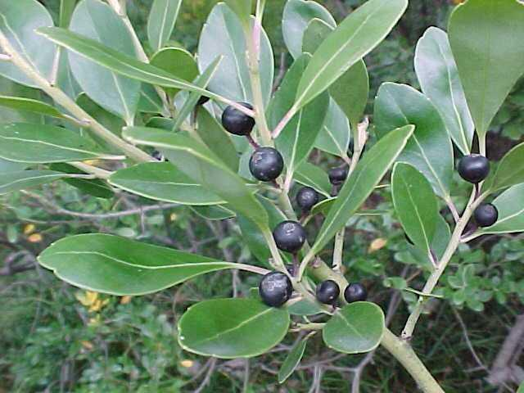
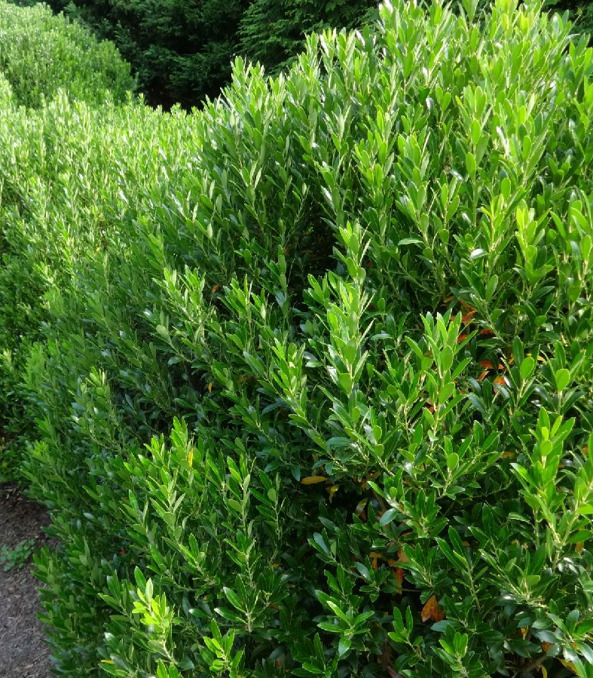
Inkberry Holly – Ilex glabra
Late season berries are an important food source for birds.
The flowers are an important nectar source for honey production
Dioecious, so need a male and a female plant.

Slide 7
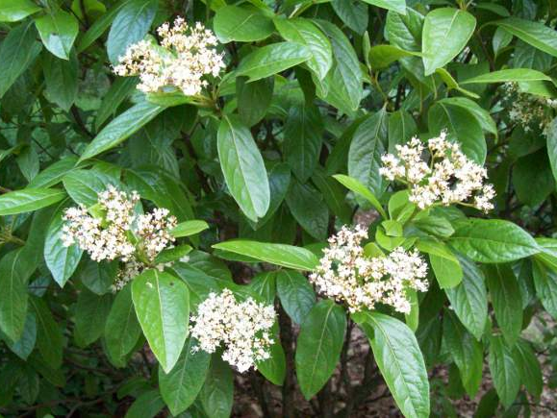
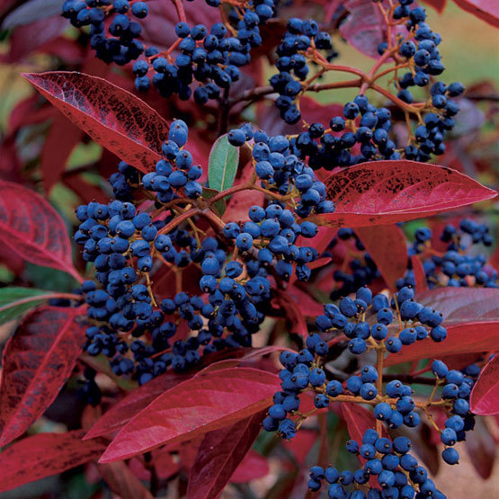
Smooth Witherod Viburnum - Viburnum nudum
high wildlife value.
Many different species of birds feed on the fruit and the flowers are an important nectar source for butterflies and insects.
The fruit is also edible for humans

Slide 8
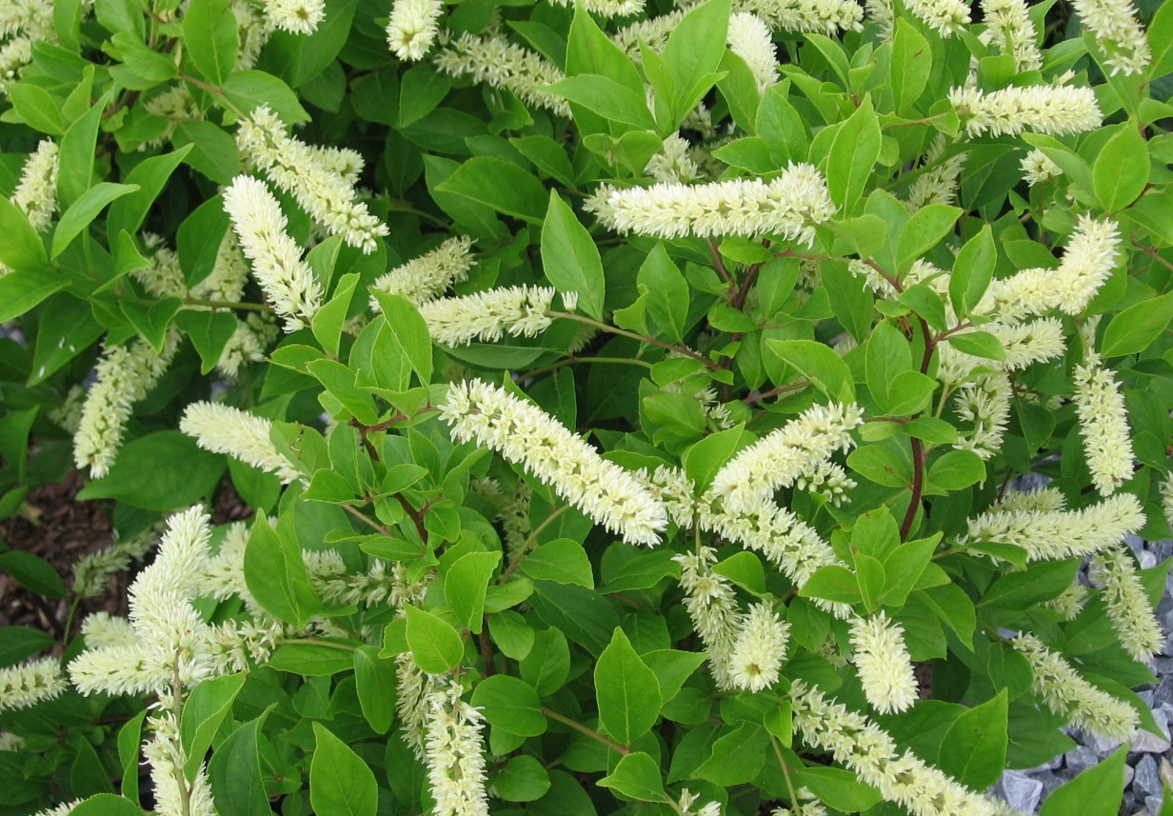
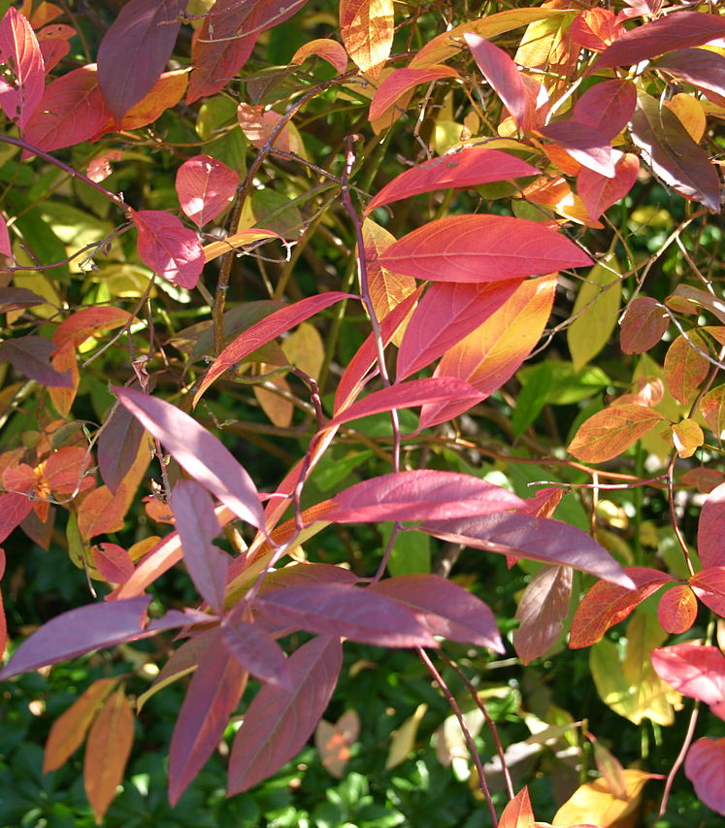
Sweetspire – Itea virginica
Sweetspire creates good shelter for animals
a nectar source for insects and butterflies
birds eat the seeds

Slide 9
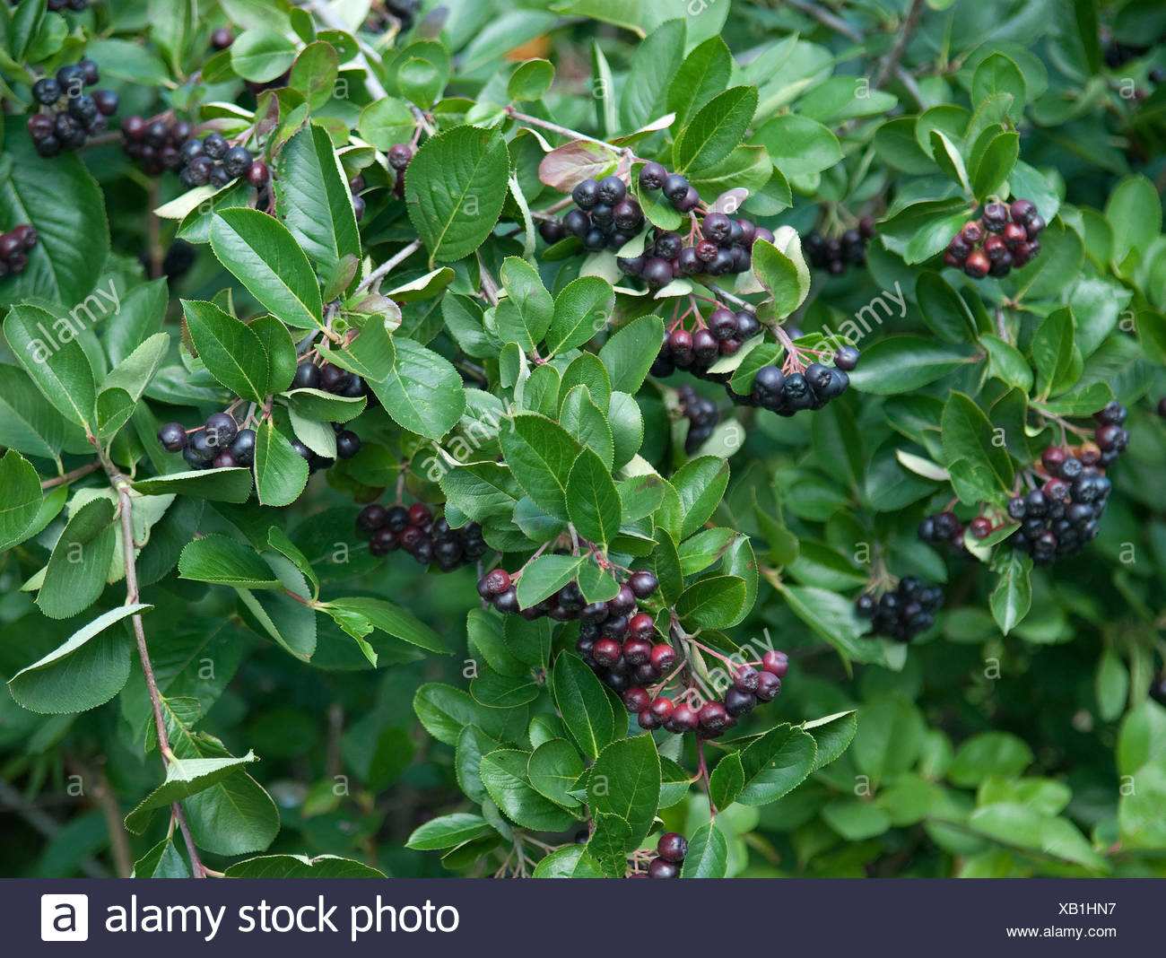
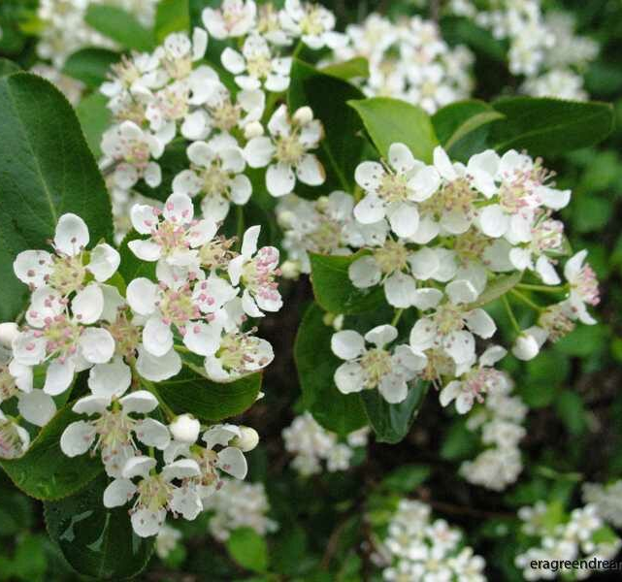
Black Chokeberry - Photinia melanocarpa
Purplish black, 1/3” - 1/2” late season fruits (September-November).
Edible berries will persist into the winter.
The berries are high in anthocyanins and antioxidants and have important nutritional value
Gorgeous spring flowering

Slide 10
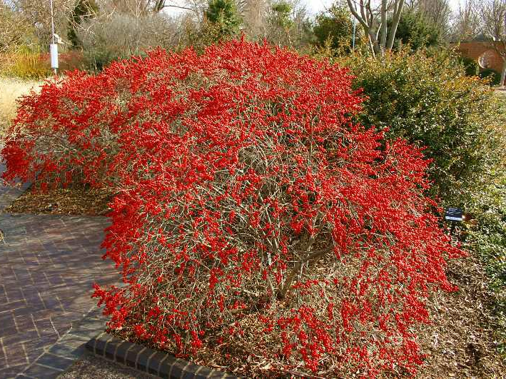
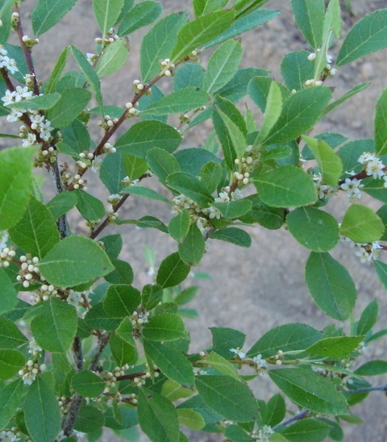
Winterberry Holly - Ilex verticillata
The fruit is favored by over 48 species of birds as well as many mammals.
Winterberry is a good nectar source and is a larval host for the Elf and Henrys Elfin Butterflies.
tough plant, high wildlife value, birds, butterflies
Provides food when there is little else
Dioecious, so need a male and a female plant.

Slide 11
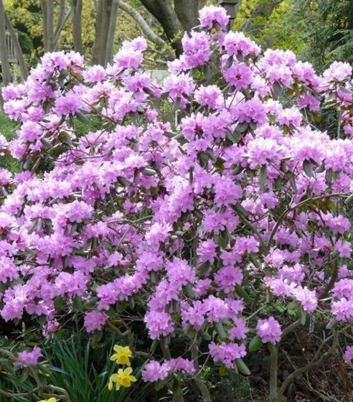
Rhododendron 'PJM
Spring and fall blooming
flowering attracts pollinating insects and hummingbirds.

Slide 12
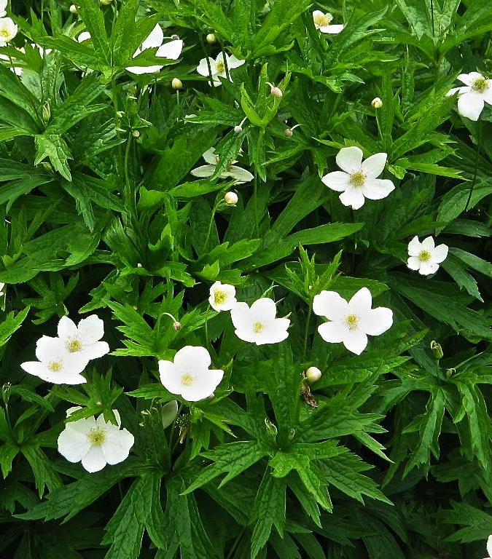
Canada anemone - Anemone canadensis
A spreader that will fill in to crowd out weeds
Very site adaptable.
Pollinated by many bees and flies.
Conspicuous white flowers.
1 - 2’
Blooms May, June, & July

Slide 13
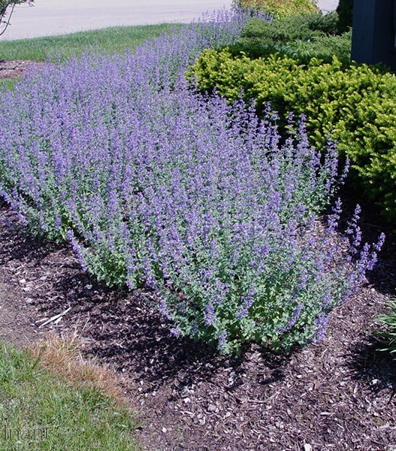
Catmint – Nepeta X FAASSENII
Township favorite
Stalks of petite, purple-blue flowers attract a wide range of pollinators, including moths, bees, butterflies and hummingbirds.
Very long blooming

Slide 14
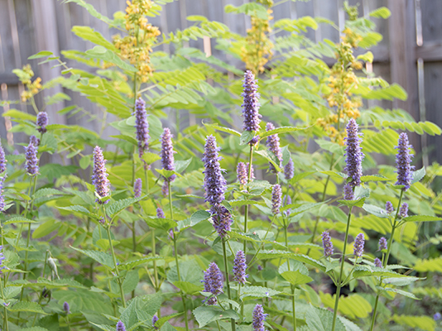
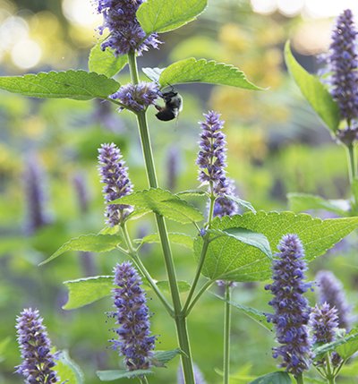
Anise Hyssop - Agastache foeniculum
Loved by Pollinators, Butterflies, & Hummingbirds,
Deer Resistant,
Host Plant
Long bloomer

Slide 15
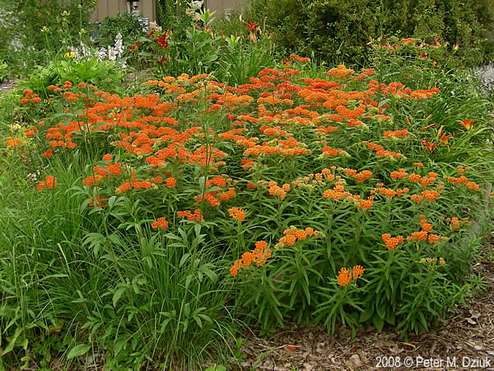
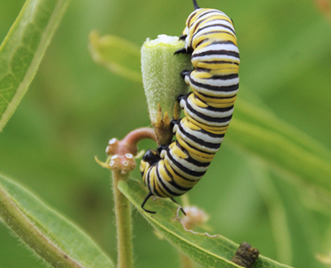
Butterflyweed- Asclepias tuberosa
attracts hoards of butterflies.
It is a larval host for the Monarch, Grey Hairstreak and Queens butterflies.
It is an important nectar source for many insects.

Slide 16
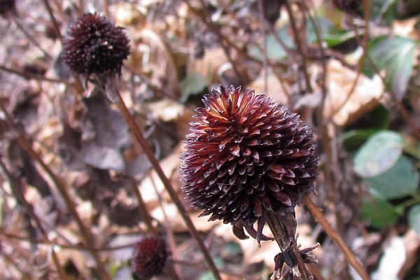
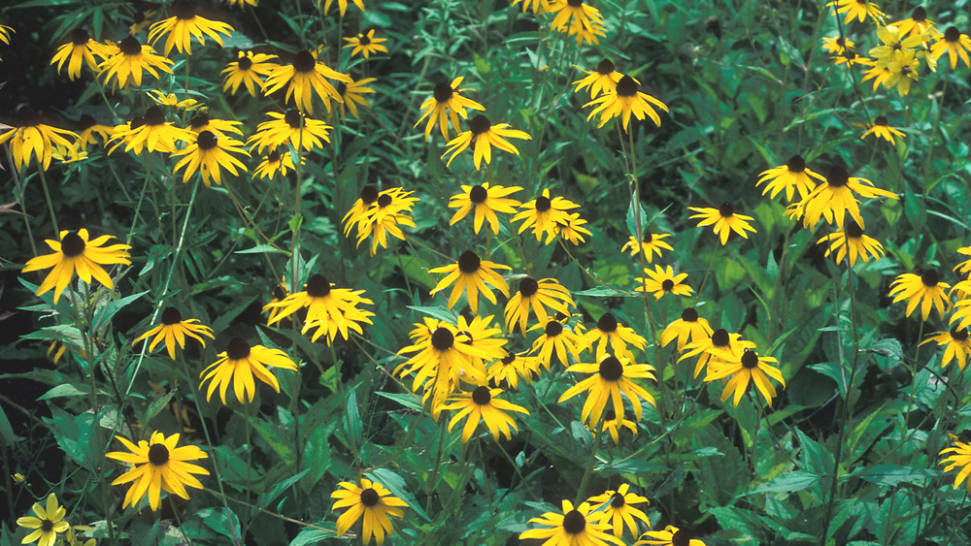
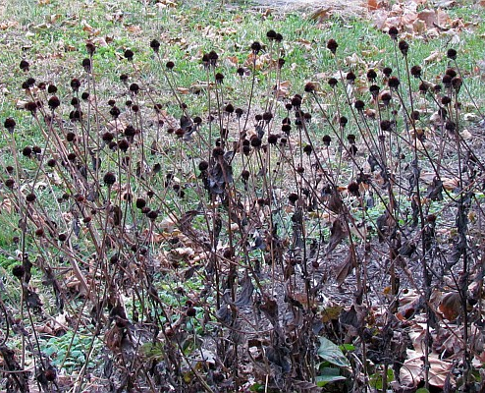
Black-eyed Susan - Rudbeckia fulgida var deamii
Important wildlife plants. T
They are an important nectar source for many pollinators.
Rudbeckia are a larval host to 16 species of butterflies and moths.
Many species of birds feed on the seedheads thoughout the fall and winter.
Deer don’t normally eat the Orange Coneflower

Slide 17
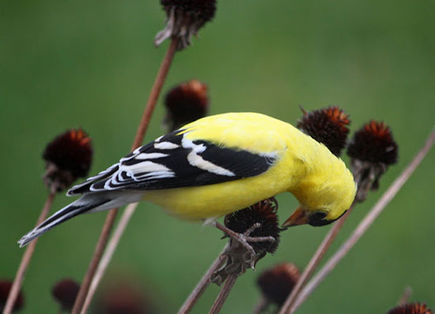
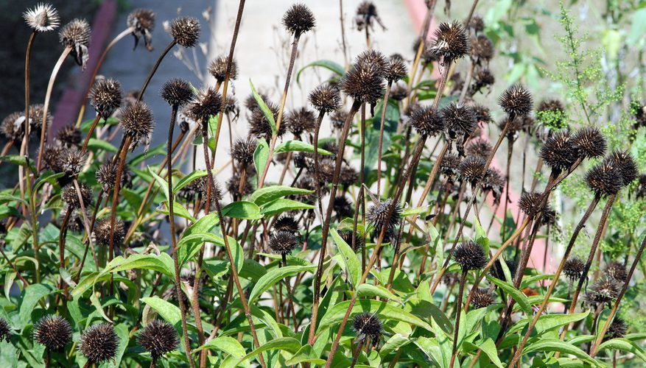
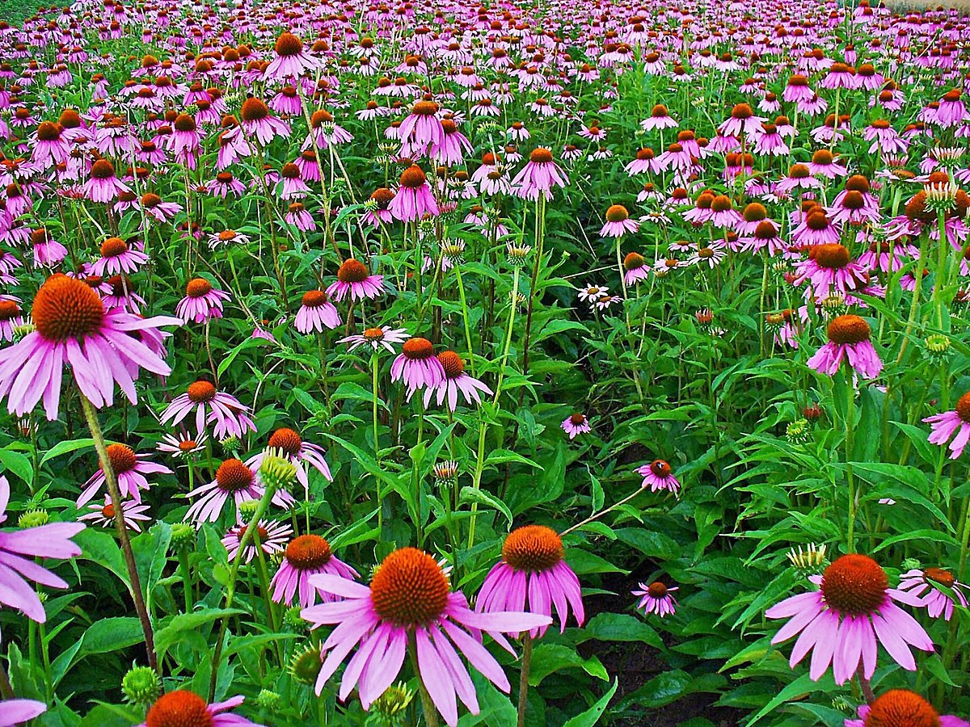
Purple Coneflowers - Echinacea purpurea
High Wildlife Value for:
  Beneficial Insects, Butterflies , Songbirds

Slide 18
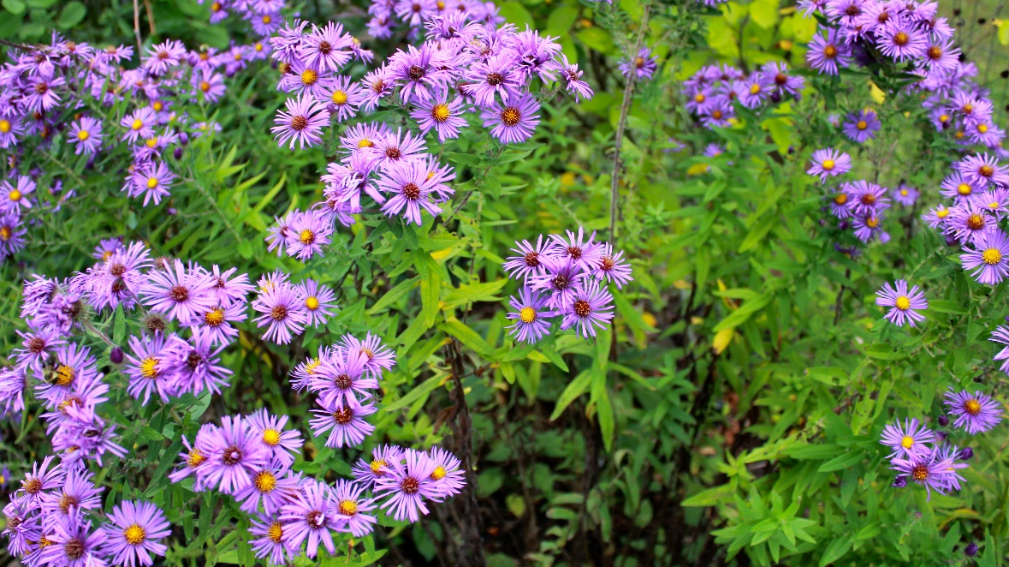
New England Aster - Aster novae angliae
very important nectar source for pollinators and butterflies, especially the migrating Monarch.
Asters are a larval source for over 100 moths and butterflies including the Pearl Crescent and Checkerspot.

Slide 19
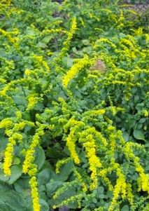
Goldenrod - Solidago sphaecelata 'Golden Fleece'
Very high wildlife value.
They are an important food source for countless pollinators including the migrating Monarchs.
Solidago species are a larval host for 115 species of butterflies and moths.
Provide food at an important time of year.

Slide 20
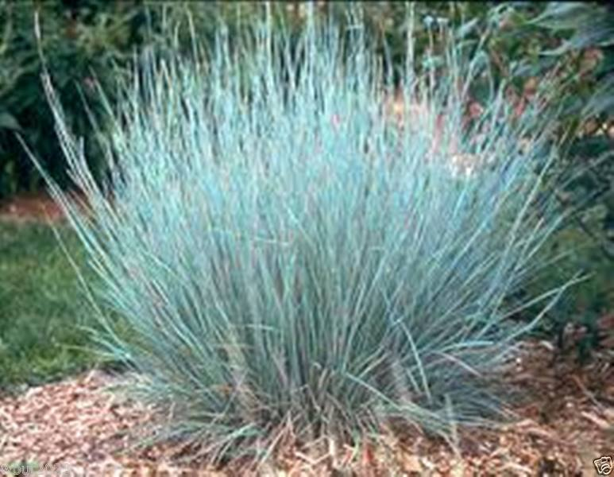
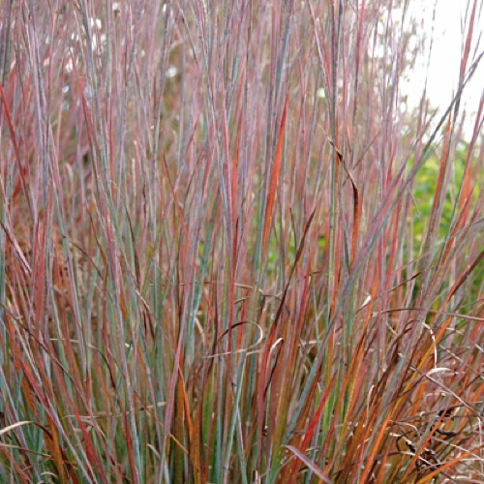
Little Bluestem - Schizachyrium scoparium 'Standing Ovation'
attracts butterflies and songbirds and provides cover for ground birds and small mammals.
Little Bluestem is a larval host for the Ottoe Skipper, Indian Skipper, Crossline Skipper, Dusted Skipper, Dixie Skipper and Cobweb Butterfly

Slide 21
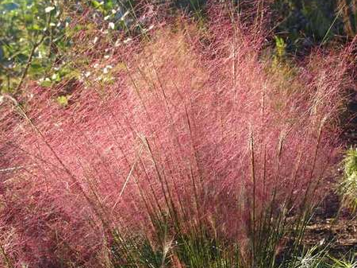
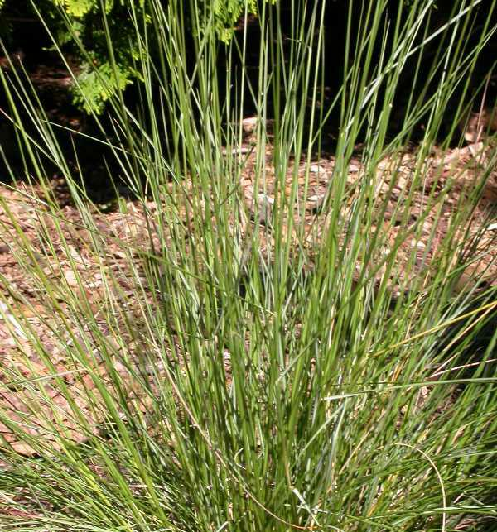
Pink Muhly Grass - Muhlenbergia capillaris
Attracts beneficial insects such as ladybugs.
Clumping habit excellent for wildlife cover.
Seed plumes are good food sources for birds.

Slide 22
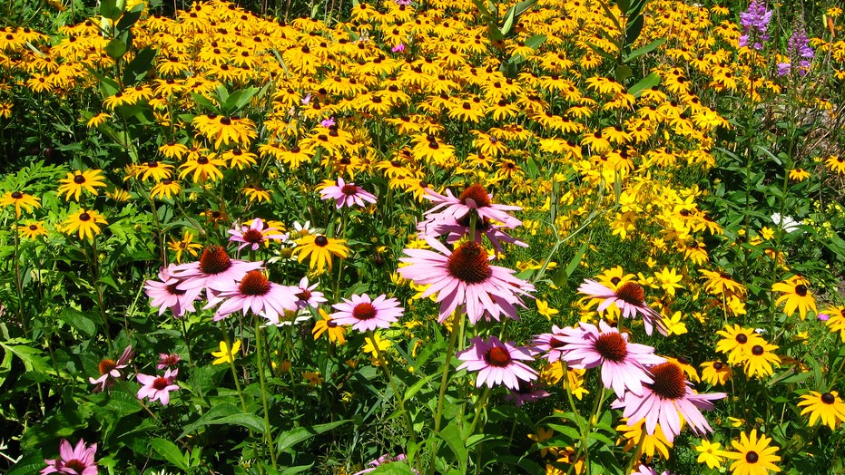
Contact
Joanne Mullowney, Chair of the Ewing Green Team and member of the Environmental Commission
ewinggreenteam@gmail.com

